Slide 1

Department of Computer Engineering
Unit-1
Register Transfer and Micro-operations
Computer Organization and Architecture-01CE1402
Prof. Kishan Makadiya

Slide 2
Outline
Register Transfer language
Register Transfer
Bus and Memory Transfers
Arithmetic Micro-Operations
Logic Micro-Operations
Shift Micro-Operations
Arithmetic logical shift unit.

Slide 3

Introduction
What is COA?
Why we need to study this?
Notes:
Computer Organization: The organization of a computer system defines how data is processed, stored, and transferred within the system. It deals with the physical components of a computer and how they interact at a hardware level. Computer organization is concerned with issues such as instruction set architecture, data representation, and the control unit's operation.
computer architecture involves the high-level design principles and the definition of the instruction set that determines how a computer system operates.

Slide 4


Register
Computer Registers are designated by capital letters.
For example,
MAR – Memory Address Register
PC – Program Counter
IR – Instruction Register
R1 – Processor Register
$$R1$$
7 | 6 | 5 | 4 | 3 | 2 | 1 | 0
Register R
Showing individual bits
15
0
15
8
7
0
$$R2$$
PC (H) | PC (L)
Numbering of bits
Divided into two parts

Slide 5
Microoperations
The operations executed on data stored in registers are called microoperations.
A microoperation is an elementary operation performed on the information stored in one or more registers.
The result of the operation may replace the previous binary information of a register or may be transferred to another register.
Example:
Shift, count, clear and load

Slide 6
Register Transfer Language
The symbolic notation used to describe the microoperation transfers among registers is called a register transfer language.
The term "register transfer" implies the availability of hardware logic circuits that can perform a stated microoperation and transfer the result of the operation to the same or another register.
A register transfer language is a system for expressing in symbolic form the microoperation sequences among the registers of a digital module.

Slide 7

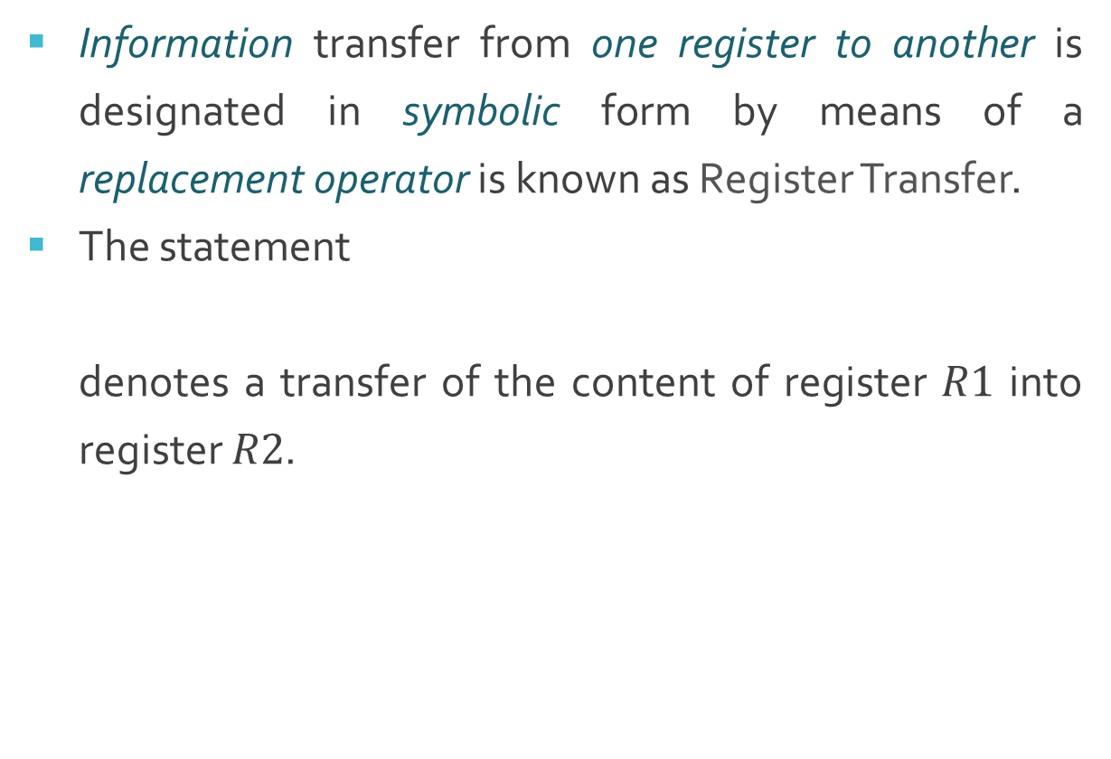
Register Transfer
Information transfer from one register to another is designated in symbolic form by means of a replacement operator is known as Register Transfer.
The statement
denotes a transfer of the content of register $R1$ into register $R2$.
$$R2←R1$$
R1
1 | 1 | 0 | 1
R2
1 | 1 | 0 | 1

Slide 8

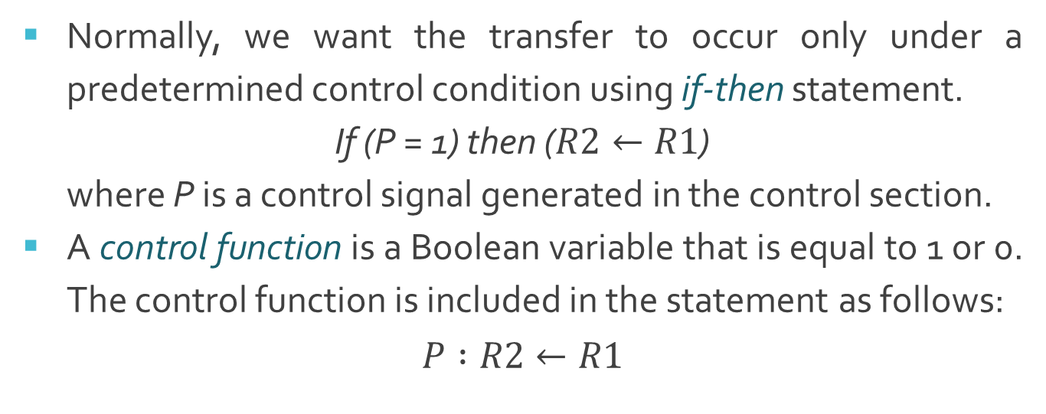

Register Transfer with Control Function
Normally, we want the transfer to occur only under a predetermined control condition using if-then statement.
If (P = 1) then ($R2←R1$)
where P is a control signal generated in the control section.
A control function is a Boolean variable that is equal to 1 or 0. The control function is included in the statement as follows:
$$P :R2←R1$$
t
t+1
Control
circuit
P
Load
$$R2$$
Clock
n
$$R1$$
Load
Transfer occurs here

Slide 9
Basic Symbols for Register Transfers
Symbol | Description | Examples
Letters (and numerals) | Denotes a register | MAR, R2
Parentheses () | Denotes a part of a register | R1(0-7), R2(H)
Arrow <- | Denotes transfer of information | R2 <- R1
Comma , | Separates two microoperations | R2 <- R1, R3 <- R4

Slide 10
Common bus system for 4 registers
A typical digital computer has many registers, and paths must be provided to transfer information from one register to another.
The number of wires will be excessive if separate lines are used between each register and all other registers in the system.
Register A
3 2 1 0
3 2 1 0
3 2 1 0
Register B
Register C

Slide 11
Common bus system for 4 registers
A more efficient scheme for transferring information between registers in a multiple-register configuration is a common bus system.
A bus structure consists of a set of common lines, one for each bit of a register, through which binary information is transferred one at a time.
One way of constructing a common bus system is with multiplexers.
The multiplexers select the source register whose binary information is then placed on the bus.

Slide 12
Common bus system for 4 registers
S₁
4-line common bus
0
S₀
0
A₃
A₂
A₁
A₀
4 x 1
MUX 3
4 x 1
MUX 2
4 x 1
MUX 1
4 x 1
MUX 0
3 2 1 0
3 2 1 0
3 2 1 0
3 2 1 0
D₂
C₂
B₂
A₂
D₁
C₁
B₁
A₁
D₀
C₀
B₀
A₀
D₂
D₁
D₀
C₂
C₁
C₀
B₂
B₁
B₀
A₂
A₁
A₀
3 2 1 0
3 2 1 0
3 2 1 0
3 2 1 0
Register D
Register C
Register B
Register A
Common bus system for 4 registers

Slide 13
Common bus system for 4 registers
The construction of a bus system for four registers is explained earlier.
Each register has four bits, numbered 0 through 3.
The bus consists of four 4 x 1 multiplexers each having four data inputs, 0 through 3, and two selection inputs, S1 and S0.
The diagram shows that the bits in the same significant position in each register are connected to the data inputs of one multiplexer to form one line of the bus.

Slide 14
Common bus system for 4 registers
The two selection lines S₁ and S₀ are connected to the selection inputs of all four multiplexers.
The selection lines choose the four bits of one register and transfer them into the four-line common bus.
When S₁S₀ = 00, the 0 data inputs of all four multiplexers are selected and applied to the outputs that form the bus.
This causes the bus lines to receive the content of register A since the outputs of this register are connected to the 0 data inputs of the multiplexers.

Slide 15
Common bus system for 4 registers
Table shows the register that is selected by the bus for each of the four possible binary values of the selection lines.
S₁ | S₀ | Register Selected
0 | 0 | A
0 | 1 | B
1 | 0 | C
1 | 1 | D

Slide 16
Common bus system for 4 registers
In general, a bus system will multiplex k registers of n bits each to produce an n-line common bus.
The number of multiplexers needed to construct the bus is equal to n, the number of bits in each register.
The size of each multiplexer must be k x 1 since it multiplexes k data lines.
For example, a common bus for eight registers of 16 bits requires
Multiplexers – 16 of (8 x 1)
Select Lines - 3

Slide 17
Tri-state Buffer (3 state Buffer)
A three-state gate is a digital circuit that exhibits three states.
Two of the states are signals equivalent to logic 1 and 0 as in a conventional gate.
The third state is high impedance state which behaves like an open circuit, which means that the output is disconnected and does not have logic significance.
Normal Input A
Output Y = A if C = 1
High-impedance if C = 0
Control Input C

Slide 18
Tri-state Buffer (3 state Buffer)
The control input determines the output state. When the control input C is equal to 1, the output is enabled and the gate behaves like any conventional buffer, with the output equal to the normal input.
When the control input C is 0, the output is disabled and the gate goes to a high-impedance state, regardless of the value in the normal input.

Slide 19
Common bus system using decoder and tri-state buffer
Bus line for bit 0
A₀
B₀
C₀
C₀
D₀
2 x 4
Decoder
1
0
1
2
3
S₁
S₀
E
Select
0
1
Enable

Slide 20
Common bus system using decoder and tri-state buffer
The construction of a bus system with three-state buffers is demonstrated in previous figure.
The outputs of four buffers are connected together to form a single bus line.
The control inputs to the buffers determine which of the four normal inputs will communicate with the bus line.
The connected buffers must be controlled so that only one three-state buffer has access to the bus line while all other buffers are maintained in a high impedance state.
One way to ensure that no more than one control input is active at any given time is to use a decoder, as shown in the figure: Bus line with three state-buffers.

Slide 21
Common bus system using decoder and tri-state buffer
When the enable input of the decoder is 0, all of its four outputs are 0, and the bus line is in a high-impedance state because all four buffers are disabled.
When the enable input is active, one of the three-state buffers will be active, depending on the binary value in the select inputs of the decoder.

Slide 22
Memory Transfer
The transfer of information from a memory word to be the outside environment is called a read operation.
The transfer of new information to be stored into the memory is called write operation.
A memory word will be symbolized by the letter M.
It is necessary to specify the address of M when writing memory transfer operations. This will be done by enclosing the address in square brackets following the letter M.

Slide 23
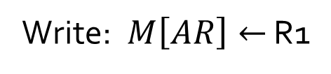
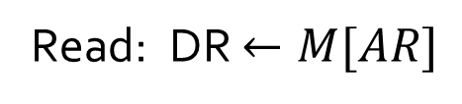
Memory Transfer
A memory unit that receives the address from a register, called the address register, symbolized by AR.
The data are transferred to another register, called the data register, symbolized by DR.
The read operation can be stated as follows:
The write operation can be stated as follows:
Read: DR $←M[AR]$
Write: $M\left[AR\right]←$ R1

Slide 24



Arithmetic Microoperations
Arithmetic micro-operations perform arithmetic operations on numeric data stored in registers.
Add Microoperation
Subtract Microoperation
$$R3←R1+R2$$
$$R3←R1−R2$$
$$R3←R1+\overline{R2}+1$$

Slide 25
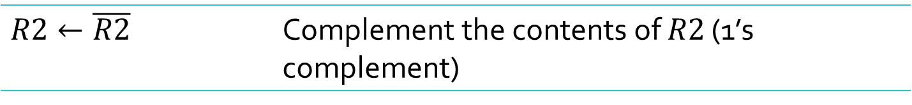
Arithmetic Microoperations
Symbolic Designation | Description
$$R3←R1+R2$$ | Contents of $R1$ plus $R2$ transferred to $R3$
$$R3←R1−R2$$ | Contents of $R1$ minus $R2$ transferred to $R3$
$$R2←\overline{R2}$$ | Complement the contents of $R2$ (1’s complement)
$$R2←\overline{R2}+1$$ | 2’s complement the contents of $R2$ (negate)
$$R3←R1+\overline{R2}+1$$ | $R1$ plus the 2’s complement of $R2$ (subtraction)
$$R1←R1+1$$ | Increment the content of $R1$ by one
$$R1←R1−1$$ | Decrement the content of $R1$ by one

Slide 26
Binary Adder
The digital circuit that generates the arithmetic sum of two binary numbers of any length is called a binary adder.
Example
C
1
1
1
0
R1
1
1
0
1
R2
+
0
1
1
1
Sum
1
0
1
0
0

Slide 27
4 – bit Binary Adder
0
1
1
1
1
0
1
1
B₃
A₃
B₂
A₂
B₁
A₁
B₀
A₀
1
1
1
0
FA
C₃
FA
C₂
FA
C₁
FA
C₀
C₄
S₃
S₂
S₁
S₀
1
0
1
0
0
C
1
1
1
0
R1
1
1
0
1
R2
+
0
1
1
1
Sum
1
0
1
0
0

Slide 28
4 – bit Binary Adder
The binary adder is constructed with full-adder circuits connected in cascade, with the output carry from one full-adder connected to the input carry of the next full-adder.
The figure shows the interconnections of four full-adders (FA) to provide a 4-bit binary adder.
The augends bits of A and the addend bits of B are designated by subscript numbers from right to left, with subscript 0 denoting the low-order bit.
The carries are connected in a chain through the full-adders.
The input carry to the binary adder is C0 and the output carry is C4.
The S outputs of the full-adders generate the required sum bits.

Slide 29
4 – bit Binary Adder
An n-bit binary adder requires n full-adders.
The output carry from each full-adder is connected to the input carry of the next-high-order full-adder.
The n data bits for the A inputs come from one register (such as R1), and the n data bits for the B inputs come from another register (such as R2). The sum can be transferred to a third register or to one of the source registers (R1 or R2), replacing its previous content.

Slide 30



Binary Adder-Subtractor
Add Microoperation
Subtract Microoperation
$$R3←R1+R2$$
$$R3←R1−R2$$
$$R3←R1+\overline{R2}+1$$
The addition and subtraction operations can be combined into one com­mon circuit by including an exclusive-OR gate with each full-adder.

Slide 31
4 – bit Binary Adder-Subtractor
B₃
A₃
B₂
A₂
B₁
A₁
B₀
A₀
1
0
1
0
1
0
1
0
1
0
M
B₃’
B₃
B₂’
B₂
B₁’
B₁
B₀’
B₀
FA
C₃
FA
C₂
FA
C₁
FA
C₀
C₄
S₃
S₂
S₁
S₀

Slide 32
4 – bit Binary Adder-Subtractor
The mode input M controls the operation.
when M = 0 the circuit is an Adder
when M = 1 the circuit becomes a Subtractor
Each exclusive-OR gate receives one input M and other input from B.
When M = 0, we have
C₀=0 & B ⊕ 0 = B
The full-adders receive the value of B, the input carry is 0, and the circuit performs A plus B.
When M = 1, we have
C₀=1 & B ⊕ 1 = B’
The B inputs are all complemented and 1 is added through the input carry. The circuit performs the operation A plus the 2's complement of B.

Slide 33
Binary Incrementar
The increment microoperation adds one to a number in a register.
C
0
0
1
R1
1
1
0
1
+
1
Sum
1
1
1
0

Slide 34
4 – bit Binary Incrementer
1
1
0
1
A₃
A₂
A₁
A₀
1
0
0
1
x
y
x
y
x
y
x
y
HA
HA
HA
HA
C
S
C
S
C
S
C
S
C₄
S₃
S₂
S₁
S₀
0
1
1
1
0

Slide 35
4 – bit Binary Incrementer
As shown in figure, one of the inputs to the least significant half-adder (HA) is connected to logic-1 and the other input is connected to the least significant bit of the number to be incremented.
The output carry from one half-adder is connected to one of the inputs of the next-higher-order half-adder.
The circuit receives the four bits from A₀ through A₃, adds one to it, and generates the incremented output in S₀ through S₃.
The output carry C₄ will be 1 only after incrementing binary 1111. This also causes outputs S₀ through S₃ to go to 0.

Slide 36
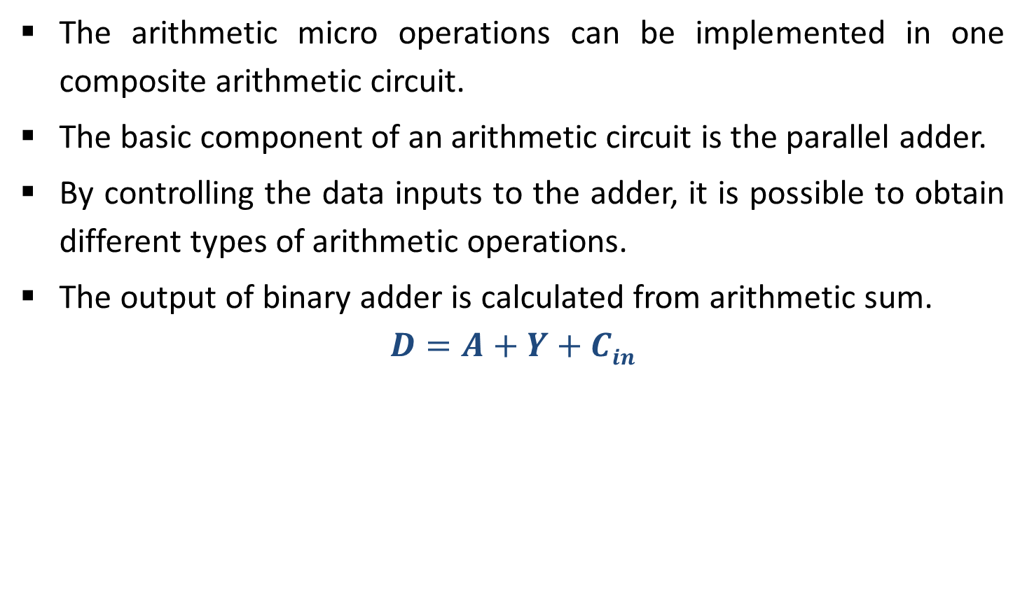
Arithmetic Circuit
The arithmetic micro operations can be implemented in one composite arithmetic circuit.
The basic component of an arithmetic circuit is the parallel adder.
By controlling the data inputs to the adder, it is possible to obtain different types of arithmetic operations.
The output of binary adder is calculated from arithmetic sum.
$$D=A+Y+Cin$$

Slide 37
4 – bit Arithmetic Circuit
Incremented content of A
D₀
D₁
D₂
D₃
C_{out}
1
C₀
C₁
C₁
C₂
C₂
C₃
C₃
C₄
FA
FA
FA
FA
X₀
Y₀
X₁
Y₁
X₂
Y₂
X₃
Y₃
0
0
0
0
4 x 1
MUX 3
4 x 1
MUX 3
4 x 1
MUX 3
4 x 1
MUX 3
S₁ S₀ 0 1 2 3
S₁ S₀ 0 1 2 3
S₁ S₀ 0 1 2 3
S₁ S₀ 0 1 2 3
1
1
0
0
C_{in}
S₀
B₀
A₁
B₁
A₂
B₂
A₃
B₃
1
S₁
A₀

Slide 38

4 – bit Arithmetic Circuit
Decrement using 2’s complement
1
1
1
1
1
0
1
1
1
0
1
-
1
2’s complement
+
1
1
1
1
1
1
0
0
1
1
1
0
0
Discard carry
$$Decrement=A+1111+0$$

Slide 39
4 – bit Arithmetic Circuit
Decremented content of A
D₀
D₁
D₂
D₃
C_{out}
0
C₀
C₁
C₁
C₂
C₂
C₃
C₃
C₄
FA
FA
FA
FA
X₀
Y₀
X₁
Y₁
X₂
Y₂
X₃
Y₃
1
1
1
1
4 x 1
MUX 3
4 x 1
MUX 3
4 x 1
MUX 3
4 x 1
MUX 3
S₁ S₀ 0 1 2 3
S₁ S₀ 0 1 2 3
S₁ S₀ 0 1 2 3
S₁ S₀ 0 1 2 3
1
0
1
0
C_{in}
S₀
B₀
A₁
B₁
A₂
B₂
A₃
B₃
1
S₁
A₀

Slide 40
4 – bit Arithmetic Circuit
Hardware implementation consists of:
4 full-adder circuits that constitute the 4-bit adder and four multiplexers for choosing different operations.
There are two 4-bit inputs A and B.
The four inputs from A go directly to the X inputs of the binary adder. Each of the four inputs from B is connected to the data inputs of the multiplexers. The multiplexer’s data inputs also receive the complement of B.

Slide 41
4 – bit Arithmetic Circuit
The other two data inputs are connected to logic-0 and logic-1.
Logic-0 is a fixed voltage value (0 volts for TTL integrated circuits)
Logic-1 signal can be generated through an inverter whose input is 0.
The four multiplexers are controlled by two selection inputs, S₁ and S₀.
The input carry C_{in} goes to the carry input of the FA in the least significant position. The other carries are connected from one stage to the next.
4-bit output D₀…D₃

Slide 42
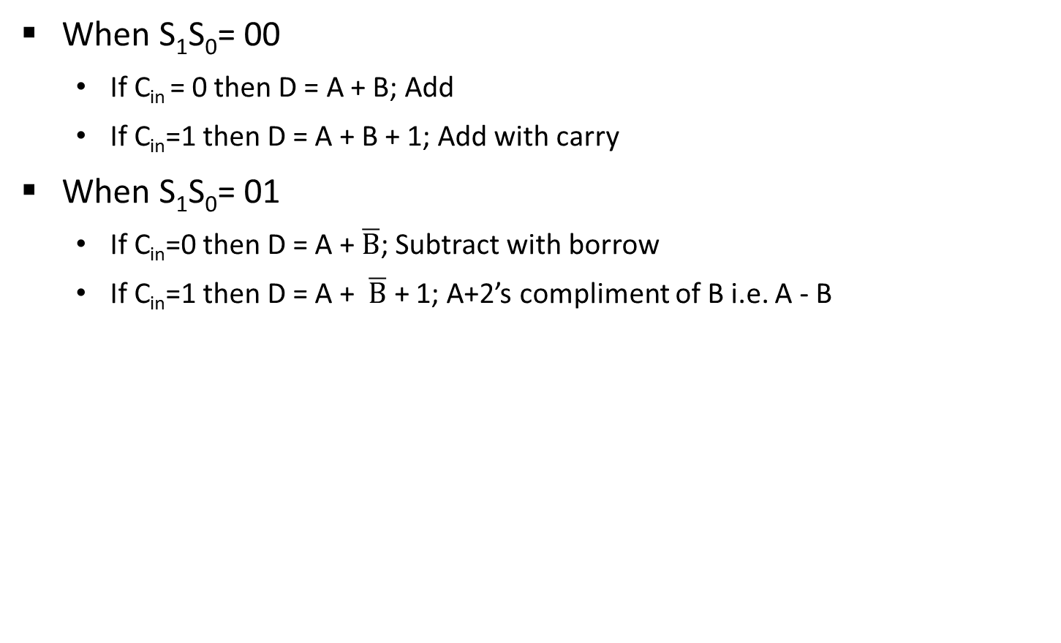
4 – bit Arithmetic Circuit
When S₁S₀= 00
If C_{in} = 0 then D = A + B; Add
If C_{in}=1 then D = A + B + 1; Add with carry
When S₁S₀= 01
If C_{in}=0 then D = A + $\overline{B}$; Subtract with borrow
If C_{in}=1 then D = A + $\overline{B}$ + 1; A+2’s compliment of B i.e. A - B

Slide 43
4 – bit Arithmetic Circuit
When S₁S₀= 10
Input B is neglected and all 0’s are inserted to Y inputs
D = A + 0 + C_{in}
If C_{in}=0 then D = A; Transfer A
If C_{in}=1 then D = A + 1; Increment A
When S₁S₀= 11
Input B is neglected and all 1’s are inserted to Y inputs
D=A – 1 + C_{in}
If C_{in}=0 then D = A – 1; 2’s compliment
If C_{in}=1 then D = A; Transfer A

Slide 44
4 – bit Arithmetic Circuit
Arithmetic Circuit Function
S₁ | S₀ | C_{in} | Y | D=A+Y+C_{in} | Microoperation
0 | 0 | 0 | B | D = A + B | Add
0 | 0 | 1 | B | D = A + B + 1 | Add with carry
0 | 1 | 0 | B’ | D = A + B’ | Subtract with borrow
0 | 1 | 1 | B’ | D = A + B’ + 1 | Subtract
1 | 0 | 0 | 0 | D = A | Transfer A
1 | 0 | 1 | 0 | D = A + 1 | Increment A
1 | 1 | 0 | 1 | D = A – 1 | Decrement A
1 | 1 | 1 | 1 | D = A | Transfer A

Slide 45


Logic Microoperations
Logic micro operations specify binary operations for strings of bits stored in registers.
These operations consider each bit of the register separately and treat them as binary variables.
Example
$$R1←R1⨁R2$$
R1
1
0
1
0
R2
$$⨁$$
1
1
0
0
R1 after P = 1
0
1
1
0

Slide 46
16 Logic Microoperations
A | B | FO | F1 | F2 | F3 | F4 | F5 | F6 | F7
0 | 0 | 0 | 0 | 0 | 0 | 0 | 0 | 0 | 0
0 | 1 | 0 | 0 | 0 | 0 | 1 | 1 | 1 | 1
1 | 0 | 0 | 0 | 1 | 1 | 0 | 0 | 1 | 1
1 | 1 | 0 | 1 | 0 | 1 | 0 | 1 | 0 | 1
Boolean Function | Microoperation | Name
$$F_{0}=0$$ | $$F←0$$ | Clear
$$F_{1}=xy$$ | $$F←A ⋀ B$$ | AND
$$F_{2}=xy′$$ | $$F←A ⋀ \overline{B}$$
$$F_{3}=x$$ | $$F←A$$ | Transfer A
$$F_{4}=x′y$$ | $$F←\overline{A} ⋀ B$$
$$F_{5}=y$$ | $$F←B$$ | Transfer B
$$F_{6}=x⊕y$$ | $$F←A⊕B$$ | Exclusive-OR
$$F_{7}=x+y$$ | $$F←A∨B$$ | OR

Slide 47
A | B | F8 | F9 | F10 | F11 | F12 | F13 | F14 | F15
0 | 0 | 1 | 1 | 1 | 1 | 1 | 1 | 1 | 1
0 | 1 | 0 | 0 | 0 | 0 | 1 | 1 | 1 | 1
1 | 0 | 0 | 0 | 1 | 1 | 0 | 0 | 1 | 1
1 | 1 | 0 | 1 | 0 | 1 | 0 | 1 | 0 | 1
16 Logic Microoperations
Boolean Function | Microoperation | Name
$$F_{8}=(x+y)′$$ | $$F←\overline{A∨B}$$ | NOR
$$F_{9}=(x⊕y)′$$ | $$F←\overline{A⊕B}$$ | Exclusive-NOR
$$F_{10}=y′$$ | $$F←\overline{B}$$ | Complement B
$$F_{11}=x+y′$$ | $$F←A∨\overline{B}$$
$$F_{12}=x′$$ | $$F←\overline{A}$$ | Complement A
$$F_{13}=x′+y$$ | $$F←\overline{A}∨B$$
$$F_{14}=(xy)′$$ | $$F←\overline{A∧B}$$ | NAND
$$F_{15}=1$$ | $$F←all 1^{′}s$$ | Set to all 1’s

Slide 48
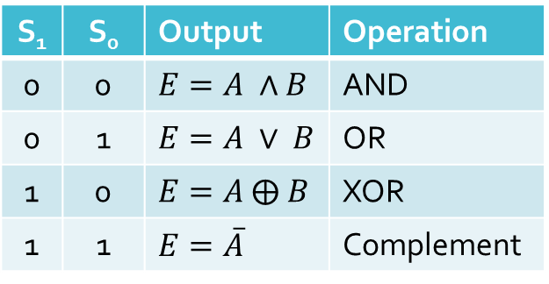
Hardware Implementation of Logic Circuit
S₁
4 x 1
MUX
S₀
A_{i}
B_{i}
0
1
2
3
E_{i}
S₁ | S₀ | Output | Operation
0 | 0 | $$E=A ∧B$$ | AND
0 | 1 | $$E=A ∨ B$$ | OR
1 | 0 | $$E=A ⨁ B$$ | XOR
1 | 1 | $$E=\overline{A}$$ | Complement

Slide 49
Hardware Implementation of Logic Circuit
Hardware implementation consists of four gates and a multiplexer.
Each of the four logic operations is generated through a gate that performs the required logic.
The outputs of the gates are applied to the data inputs of the multiplexer.
The two selection inputs S₁ and S₀ choose one of the data inputs of the multiplexer and direct its value to the output.

Slide 50
Applications of Logic Microoperations
Selective Set Operation
The selective-set operation sets to 1 the bits in register A where there are corresponding 1's in register B.
It does not affect bit positions that have 0's in B.
The OR microoperation can be used to selectively set bits of a register.
1
0
1
0
A before
1
1
0
0
B (logic operand)
1
1
1
0
A after

Slide 51
Applications of Logic Microoperations
Selective Complement Operation
The selective-complement operation complements bits in A where there are corresponding 1's in B.
It does not affect bit positions that have 0's in B.
The exclusive - OR microoperation can be used to selectively set bits of a register.
1
0
1
0
A before
1
1
0
0
B (logic operand)
0
1
1
0
A after

Slide 52
Applications of Logic Microoperations
Selective Clear Operation
The selective-clear operation clears to 0 the bits in A only where there are corresponding 1's in B.
It does not affect bit positions that have 0's in B.
The corresponding logic microoperation is A ← A ∧ B’.
1
0
1
0
A before
1
1
0
0
B (logic operand)
0
0
1
0
A after

Slide 53
Applications of Logic Microoperations
Mask Operation
The mask operation is similar to the selective-clear operation except that the bits of A are cleared only where there are corresponding 0’s in B.
The mask operation is an AND microoperation.
1
0
1
0
A before
1
1
0
0
B (logic operand)
1
0
0
0
A after

Slide 54
Applications of Logic Microoperations
Insert Operation
The insert operation inserts a new value into a group of bits.
A mask operation to clear the desired bit positions, followed by an OR operation to introduce the new bits into the desired positions
The mask operation is an AND microoperation and the insert operation is an OR microoperation.
Suppose you wanted to introduce 1010 into the high order four bits of A: 0001 1001 A (Original) 1010 1001 A (Desired)
Mask
Insert
A
0
0
0
1
1
0
0
1
A
0
0
0
0
1
0
0
1
B
0
0
0
0
1
1
1
1
B
1
0
1
0
0
0
0
0
A
0
0
0
0
1
0
0
1
A
1
0
1
0
1
0
0
1

Slide 55
Example
Suppose you wanted to introduce 1010 into the low order four bits of A: 1011 0001 A (Original) 1011 1010 A (Desired)
1011 0001 A (Original)
1111 0000 Mask
1011 0000 A (Intermediate)
1011 0000 A (Intermediate)
0000 1010 Added bits
1011 1010 A (Desired)

Slide 56
Applications of Logic Microoperations
Clear Operation
The clear operation compares the words in A and B and produces an all 0’s result if the two numbers are equal.
This operation is achieved by an exclusive-OR microoperation.
1
0
1
0
A
1
0
1
0
B
0
0
0
0
A ← A ⊕ B

Slide 57
Operation | Description
SELECTIVE SET | If a bit in B is set to 1, that same position in A gets set to 1, otherwise that bit in A keeps its previous value.
SELECTIVE COMPLEMENT | If a bit in B is set to 1, that same position in A gets complemented from its original value, otherwise it is unchanged.
SELECTIVE CLEAR | If a bit in B is set to 1, that same position in A gets set to 0, otherwise it is unchanged.
MASK OPERATION | If a bit in B is set to 0, that same position in A gets set to 0, otherwise it is unchanged.
CLEAR OPERATION | In a clear operation, compares the word in A & B and produces an all 0’s result if the two numbers are equal.
INSERT OPERATION | An insert operation is used to introduce a specific bit pattern into A register, leaving the other bit positions unchanged.

Slide 58
Operation | Description
SELECTIVE SET | If a bit in B is set to 1, that same position in A gets set to 1, otherwise that bit in A keeps its previous value.
SELECTIVE COMPLEMENT | If a bit in B is set to 1, that same position in A gets complemented from its original value, otherwise it is unchanged.
SELECTIVE CLEAR | If a bit in B is set to 1, that same position in A gets set to 0, otherwise it is unchanged.
MASK OPERATION | If a bit in B is set to 0, that same position in A gets set to 0, otherwise it is unchanged.
CLEAR OPERATION | In a clear operation, compares the word in A & B and produces an all 0’s result if the two numbers are equal.
INSERT OPERATION | An insert operation is used to introduce a specific bit pattern into A register, leaving the other bit positions unchanged.

Slide 59
Shift Microoperations
Shift microoperations are used for serial transfer of data.
Used in conjunction with arithmetic, logic and other data processing operations.
The content of the register can be shifted to the left or the right.
The first flip-flop receives its binary information from the serial input.
The information transferred through the serial input determines the type of shift.

Slide 60
Types of shift
Logical Shift
A logical shift is one that transfers 0 through the serial input.
shl - logical shift left
shr - logical shift right
R1
1 | 1 | 0 | 1
R1
1 | 1 | 0 | 1
R1
1 | 0 | 1 | 0
R1
0 | 1 | 1 | 0

Slide 61
Types of shift
Circular Shift
A circular shift (also known as a rotate operation) circulates the bits of the register around the two ends without loss of information.
This is accomplished by connecting the serial output of the shift register to its serial input.
cil - circular shift left
cir - circular shift right
R1
1 | 1 | 0 | 1
R1
1 | 1 | 0 | 1
R1
1 | 0 | 1 | 1
R1
1 | 1 | 1 | 0

Slide 62
Types of shift
Arithmetic Shift
An arithmetic shift is a micro-operation that shifts a signed binary number to the left or right.
An arithmetic shift-left multiplies a signed binary number by 2.
An arithmetic shift-right divides the number by 2.
ashl - arithmetic shift left
ashr - arithmetic shift right
R1
1 | 1 | 0 | 1
R1
1 | 1 | 0 | 1
R1
1 | 0 | 1 | 0
R1
1 | 1 | 1 | 0

Slide 63
Arithmetic Shift
A right arithmetic shift operation:
A left arithmetic shift operation:
sign
bit
0
sign
bit

Slide 64
4 - bit combinational circuit shifter (HARDWARE IMPLEMENTATION OF SHIFT MICROOPERATIONS)
Select
0 – Shift right
1 – Shift left
0
S
0
1
0
H₀
I_{R}
MUX
1
A₀
1
A₁
S
0
1
1
H₁
0
MUX
A₂
1
A₃
S
0
1
1
H₂
MUX
S | H₀ | H₁ | H₂ | H₃
0 | I_{R} | A₀ | A₁ | A₂
1 | A₁ | A₂ | A₃ | I_{L}
S
0
1
0
H₃
MUX
I_{L}

Slide 65
4 - bit combinational circuit shifter
The 4-bit shifter has four data inputs, A₀ through A₃ and four data outputs, H₀ through H₃.
There are two serial inputs, one for shift left (I_{L}) and the other for shift right (I_{L}).
When the selection input S = 0, the input data are shifted right (down in the diagram).
When S = 1, the input data are shifted left (up in the diagram).
The two serial inputs can be controlled by another multiplexer to provide the three possible types of shifts.

Slide 66
4 – bit Arithmetic Logic Shift Unit
Instead of having individual registers performing the micro operations directly, computer systems employ a number of storage registers connected to a common operational unit called an arithmetic logic unit, abbreviated ALU.
To perform a microoperation, the contents of specified registers are placed in the inputs of the common ALU.
The ALU performs an operation and the result of the operation is then transferred to a destination register.
The arithmetic, logic, and shift circuits introduced in previous sections can be combined into one ALU with common selection variables.

Slide 67
4 – bit Arithmetic Logic Shift Unit
S₃
S₂
S₁
C_{i}
S₀
One stage of arithmetic circuit
D_{i}
S₁
S₀
0
1
2
3
4 x 1
MUX
F_{i}
C_{i} +1
One stage of logic circuit
E_{i}
B_{i}
A_{i}
A_{i-1}
shr
A_{i+1}
shl

Slide 68
4 – bit Arithmetic Logic Shift Unit
Each operation is selected with five variables S3, S2, S1, S0 and C_{in}. The input carry C_{in} is used for selected an arithmetic operation only.
Table is lists the 14 operation of the ALU. The first eight are arithmetic operation and are selected with S3S2 = 00.
Next four are logic operations and are selected S3S2 = 01.
Input carry has no effect during the logic operations and is marked with don’t-care X’s.
Last two operation are shift operations and are selected with S3S2 = 10 & 11. other three selection inputs have no effect on the shift.

Slide 69
4 – bit Arithmetic Logic Shift Unit
ALU Function
S₃ | S₂ | S₁ | S₀ | C_{in} | Operation | Function
0 | 0 | 0 | 0 | 0 | F = A | Transfer A
0 | 0 | 0 | 0 | 1 | F = A + 1 | Increment A
0 | 0 | 0 | 1 | 0 | F = A + B | Addition
0 | 0 | 0 | 1 | 1 | F = A + B + 1 | Add with carry
0 | 0 | 1 | 0 | 0 | F = A + B’ | Subtract with borrow
0 | 0 | 1 | 0 | 1 | F = A + B’ + 1 | Subtraction
0 | 0 | 1 | 1 | 0 | F = A – 1 | Decrement
0 | 0 | 1 | 1 | 1 | F = A | Transfer A

Slide 70
4 – bit Arithmetic Logic Shift Unit
S₃ | S₂ | S₁ | S₀ | C_{in} | Operation | Function
0 | 1 | 0 | 0 | x | F = A ^ B | AND
0 | 1 | 0 | 1 | x | F = A v B | OR
0 | 1 | 1 | 0 | x | F = A ⊕ B | XOR
0 | 1 | 1 | 1 | X | F = A’ | Complement A
1 | 0 | x | x | x | F = shr A | Shift right A into F
1 | 1 | x | x | x | F = shl A | Shift left A into F

Slide 71
Thank You!!!

Slide 72
Exercise
1. Design a 4-bit combinational circuit decrementer using four full-adder circuits.
2. Design a digital circuit that performs the four logic operations of exclusive-OR, exclusive-NOR, NOR and NAND.
3. Register A holds the 8-bit binary 11011001. Determine the B operand and the logic microoperation to be performed in order to change the value in A to:
01101101
11111101
4. Starting from an initial value of R = 11011101, determine the sequence of binary values in R after a logical shift-left, followed by a circular shift-right, followed by a logical shift-right and a circular shift-left.

Slide 73
